Slide 1
Examples
example 3주차

Slide 2
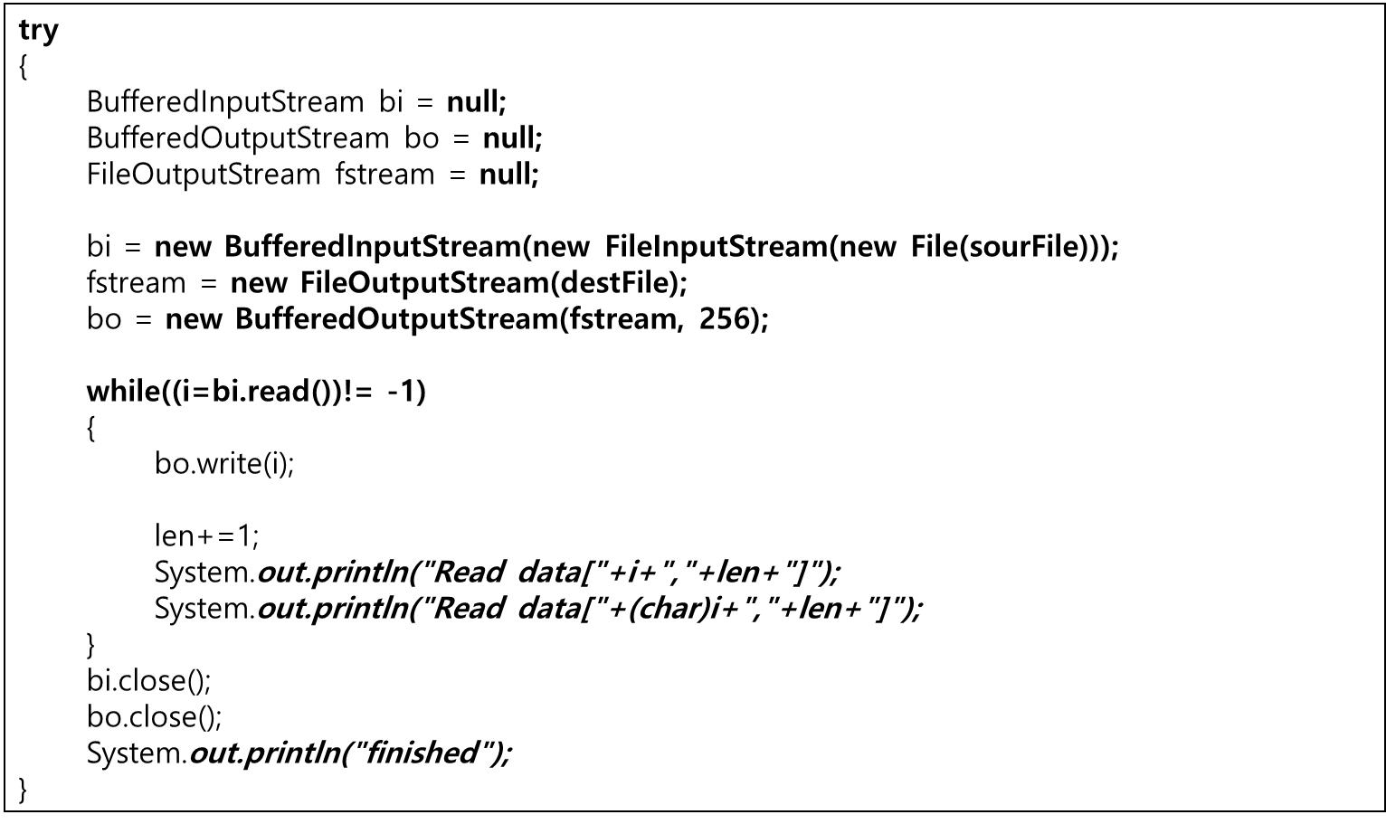
BufferedByteStreamDo.java

Slide 3
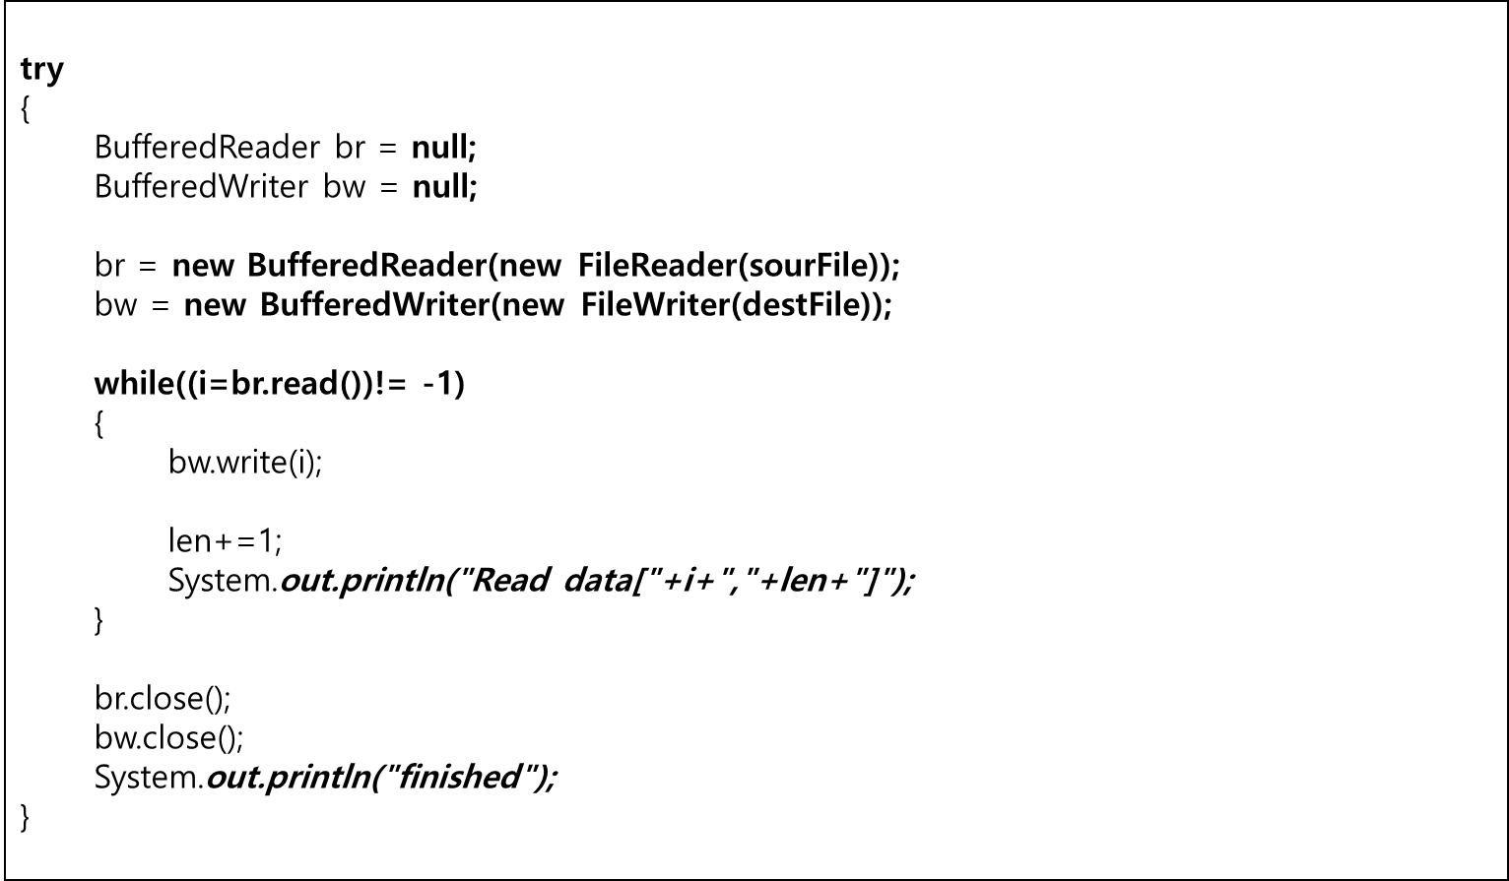
BufferedCharStreamDo.java

Slide 4
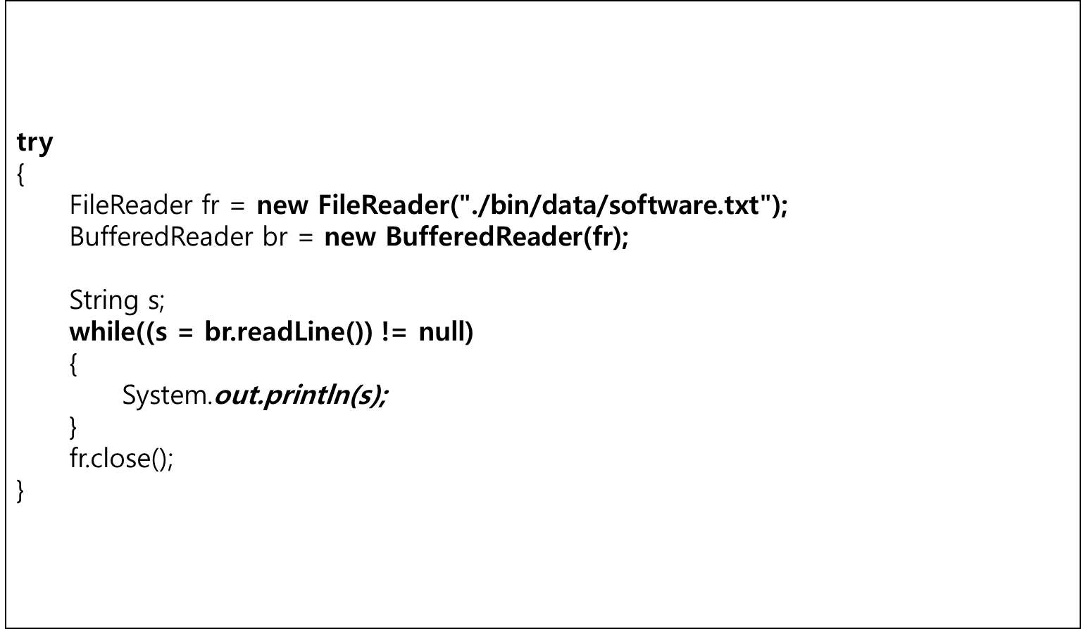
FileReaderDo.java

Slide 5
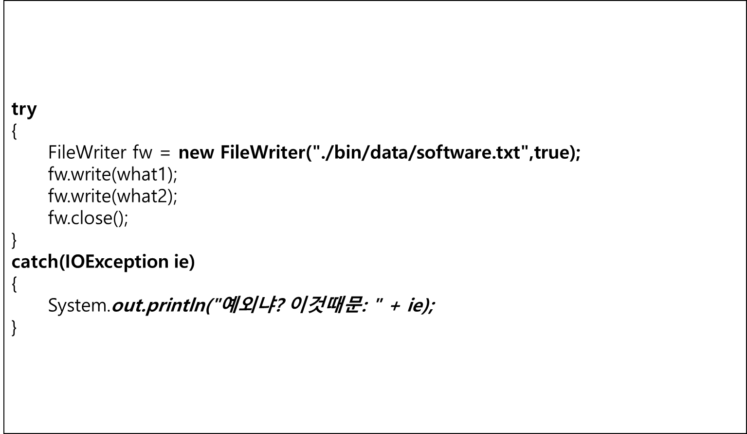
FileWriterDo.java

Slide 6
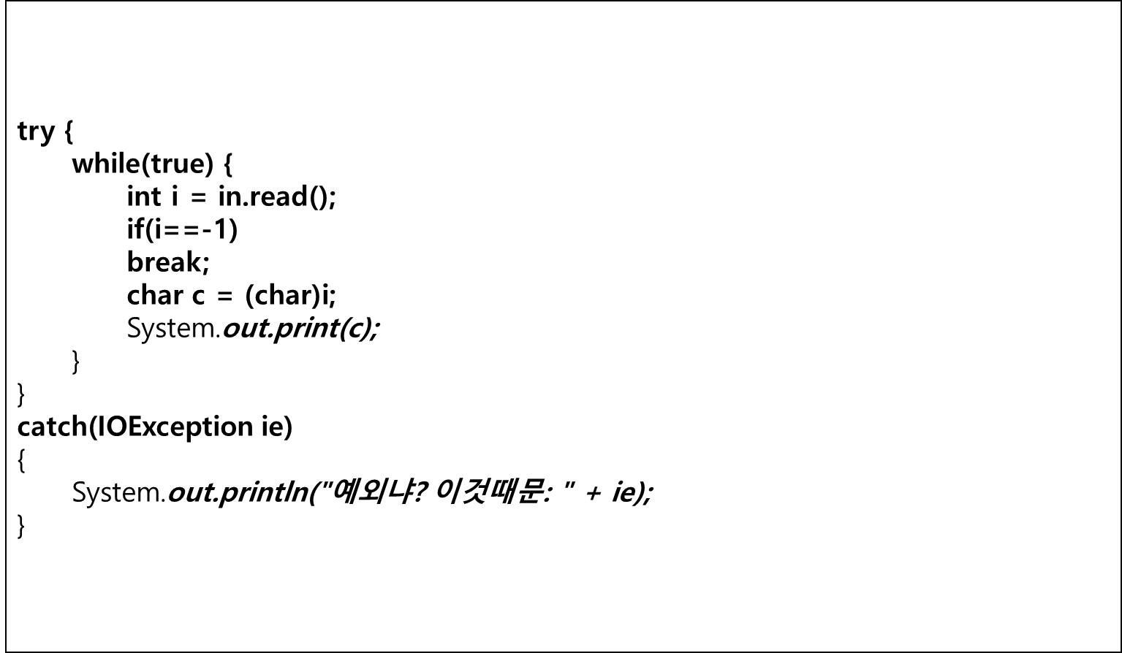
InputStreamDo.java

Slide 7
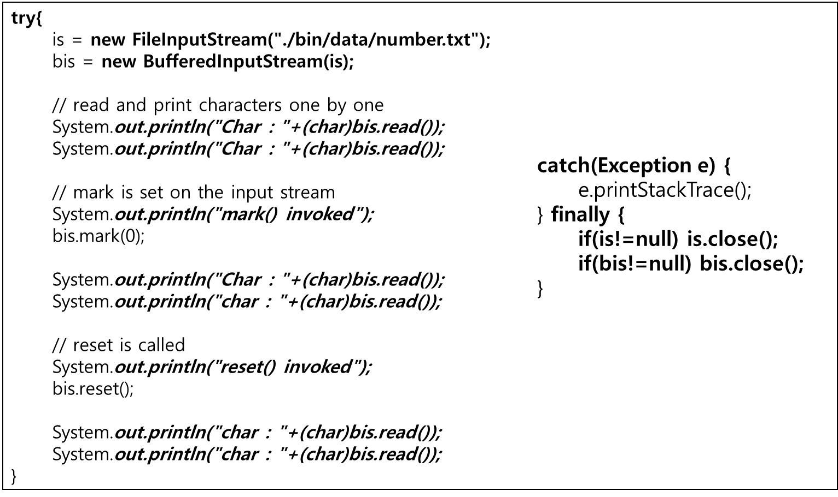
MarkResetDo.java

Slide 8
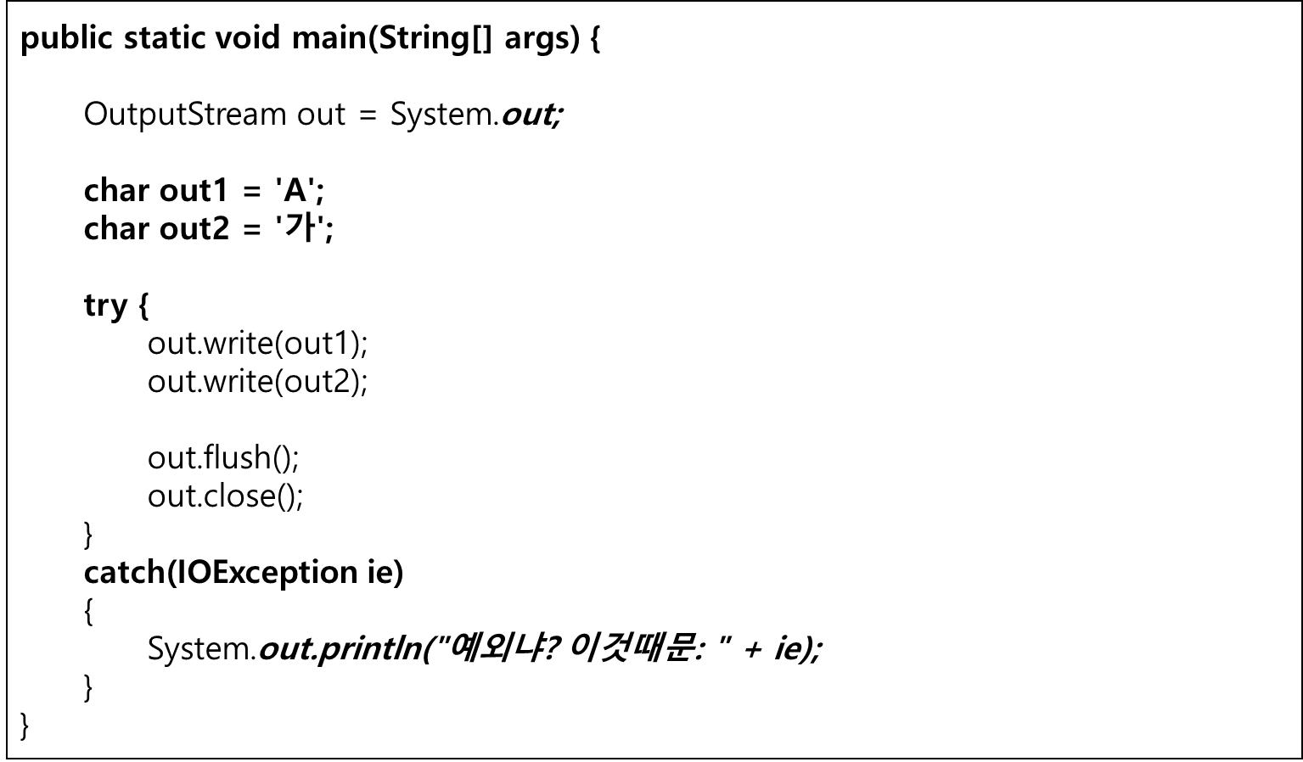
OutputStreamDo.java

